Slide 1
Slides for deep learning

Slide 2
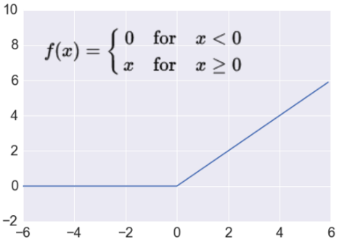

Slide 4




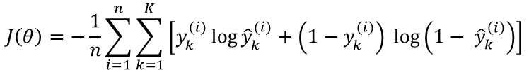
Loss functions and output
Classification
Regression
Training
examples
R^{n} x {class_1, ..., class_n}
(one-hot encoding)
R^{n} x R^{m}
Output
Layer
Soft-max
[map R^{n} to a probability distribution]
Linear (Identity)
or Sigmoid
f(x)=x
Cost (loss)
function
Cross-entropy
Mean Squared Error
$$J\left(θ\right)= \frac{1}{n}\sum_{i=1}^{n}{{\left(y^{(i)}−{\hat{y}}^{(i)}\right)}^{2}}$$
$$J\left(θ\right)=−\frac{1}{n}\sum_{i=1}^{n}{\sum_{k=1}^{K}{\left[y_{k}^{(i)}\log{{\hat{y}}_{k}^{(i)}+\left(1−y_{k}^{(i)}\right) }\log\left(1− {\hat{y}}_{k}^{\left(i\right)}\right)\right]}}$$
Mean Absolute Error
$$J\left(θ\right)= \frac{1}{n}\sum_{i=1}^{n}{\left|y^{(i)}−{\hat{y}}^{(i)}\right|}$$
List of loss functions
Notes:
Exponentiate to make it positive
MSE has nice mathematical properties which makes it easier to compute the gradient
Because of the square, large errors have relatively greater influence on MSE.
Therefore, MAE is more robust to outliers since it does not make use of square.

Slide 5
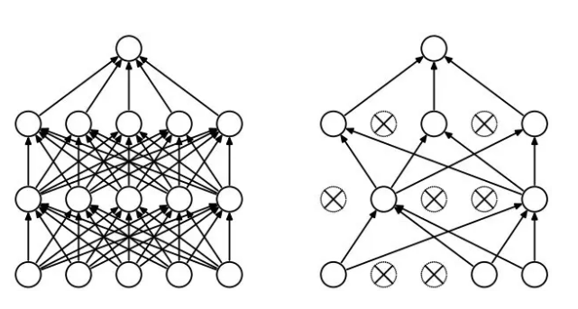
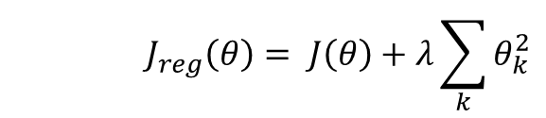
Regularization
Dropout
Randomly drop units (along with their connections) during training
Each unit retained with fixed probability p, independent of other units
Hyper-parameter p to be chosen (tuned)
Srivastava, Nitish, et al. "Dropout: a simple way to prevent neural networks from overfitting." Journal of machine learning research (2014)
L2 = weight decay
Regularization term that penalizes big weights, added to the objective
Weight decay value determines how dominant regularization is during gradient computation
Big weight decay coefficient → big penalty for big weights
$$J_{reg}\left(θ\right)= J\left(θ\right)+λ\sum_{k}{θ_{k}^{2}}$$
Early-stopping
Use validation error to decide when to stop training
Stop when monitored quantity has not improved after n subsequent epochs
n is called patience

Slide 6
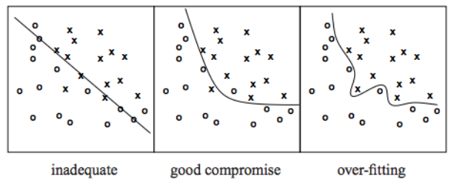
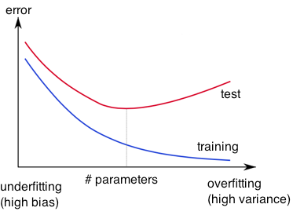
Overfitting
http://wiki.bethanycrane.com/overfitting-of-data
Learned hypothesis may fit the training data very well, even outliers (noise) but fail to generalize to new examples (test data)
https://www.neuraldesigner.com/images/learning/selection_error.svg

Slide 7
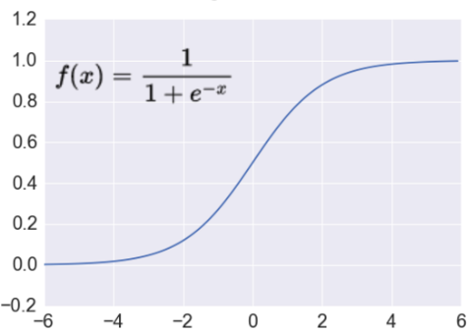

Activation: Sigmoid
Takes a real-valued number and “squashes” it into range between 0 and 1.
$$R^{n}→\left[0,1\right]$$
http://adilmoujahid.com/images/activation.png
Nice interpretation as the firing rate of a neuron
0 = not firing at all
1 = fully firing
Sigmoid neurons saturate and kill gradients, thus NN will barely learn
when the neuron’s activation are 0 or 1 (saturate)
gradient at these regions almost zero
almost no signal will flow to its weights
if initial weights are too large then most neurons would saturate

Slide 8
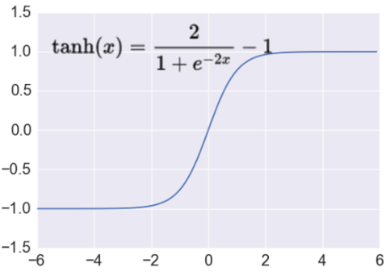
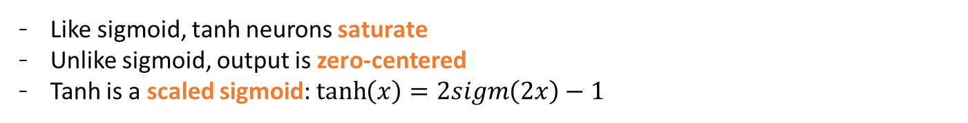

Activation: Tanh
Takes a real-valued number and “squashes” it into range between -1 and 1.
$$R^{n}→\left[−1,1\right]$$
http://adilmoujahid.com/images/activation.png
Like sigmoid, tanh neurons saturate
Unlike sigmoid, output is zero-centered
Tanh is a scaled sigmoid: $\tanh\left(x\right)=2sigm\left(2x\right)−1$
Notes:
not zero-centered: later layers of processing would be receiving data that is not zero-centered.
if data coming into a neuron is always positive then the gradient on the weights will be either all be positive, or all negative (depending on the gradient of the whole expression). Could introduce undesirable zig-zagging dynamics in the gradient weight updates. However, once these gradients are added up across a data batch the final weight update can have variable signs, somewhat mitigating this issue.

Slide 9


Activation: ReLU
Takes a real-valued number and thresholds it at zero
$$f\left(x\right)= max⁡(0,x)$$
$$R^{n}→R_{+}^{n}$$
http://adilmoujahid.com/images/activation.png
Most Deep Networks use ReLU nowadays
Trains much faster
accelerates the convergence of SGD
due to linear, non-saturating form
Less expensive operations
compared to sigmoid/tanh (exponentials etc.)
implemented by simply thresholding a matrix at zero
More expressive
Prevents the gradient vanishing problem
Notes:
ReLU units can “die”
large gradient flowing through a ReLU could cause weights to update in such a way that the neuron will never activate on any datapoint again
gradient flowing through the unit will forever be zero from that point on
With a proper setting of the learning rate this is less frequently an issue

Slide 10
Convolutional Neural Networks (CNNs)
Main CNN idea for text:
Compute vectors for n-grams and group them afterwards
max pool
2x2 filters
and stride 2
https://shafeentejani.github.io/assets/images/pooling.gif

Slide 11
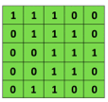

Convolutional Neural Networks (CNNs)
Main CNN idea for text:
Compute vectors for n-grams and group them afterwards
Example: “this takes too long” compute vectors for:
This takes, takes too, too long, this takes too, takes too long, this takes too long
Convolutional
3x3 filter
Input matrix
http://deeplearning.stanford.edu/wiki/index.php/Feature_extraction_using_convolution
Notes:
http://www.asimovinstitute.org/neural-network-zoo/

Slide 12
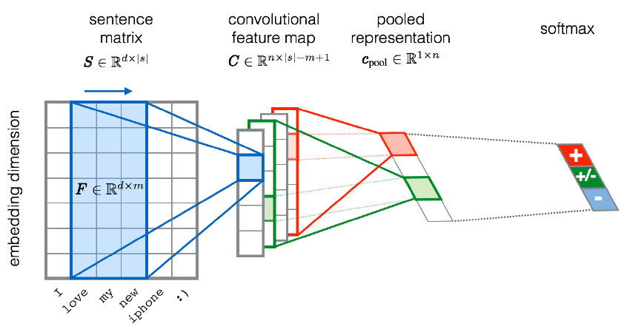
CNN for text classification
Severyn, Aliaksei, and Alessandro Moschitti. "UNITN: Training Deep Convolutional Neural Network for Twitter Sentiment Classification." SemEval@ NAACL-HLT. 2015.
Notes:
the width m of the convolution filters is set to 5
n = 300 feature maps
first layer embeds words into low-dimensional vectors.

Slide 13
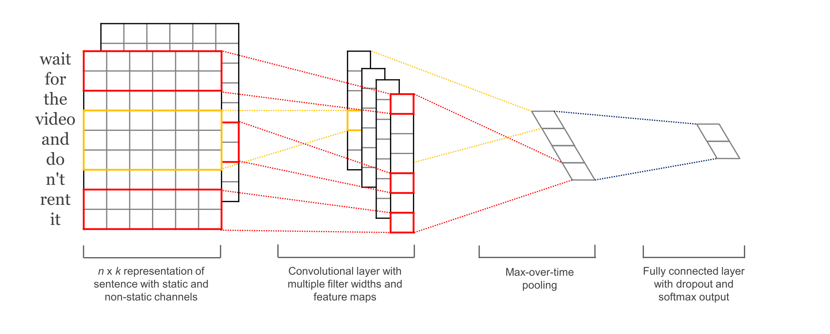
CNN with multiple filters
Kim, Y. “Convolutional Neural Networks for Sentence Classification”, EMNLP (2014)
sliding over 3, 4 or 5 words at a time

Slide 14
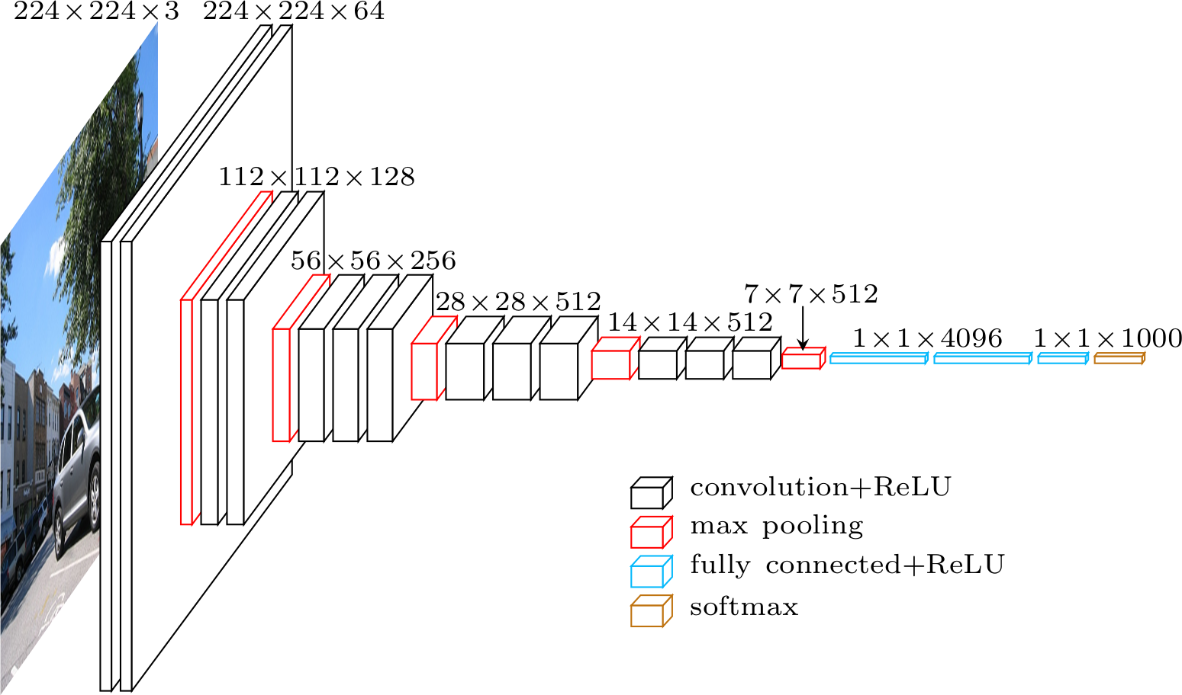

Slide 15
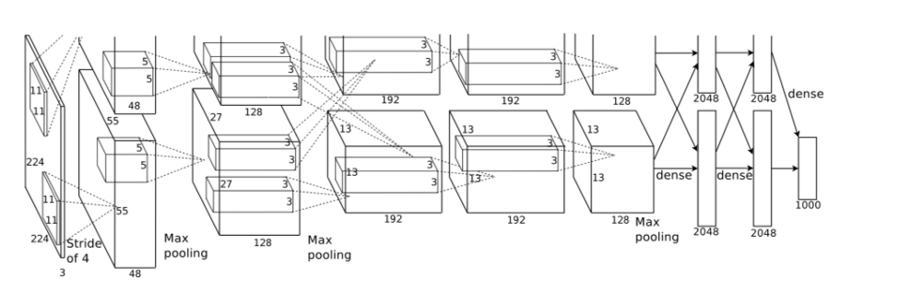

Slide 16
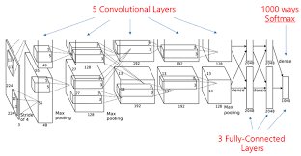

Slide 17
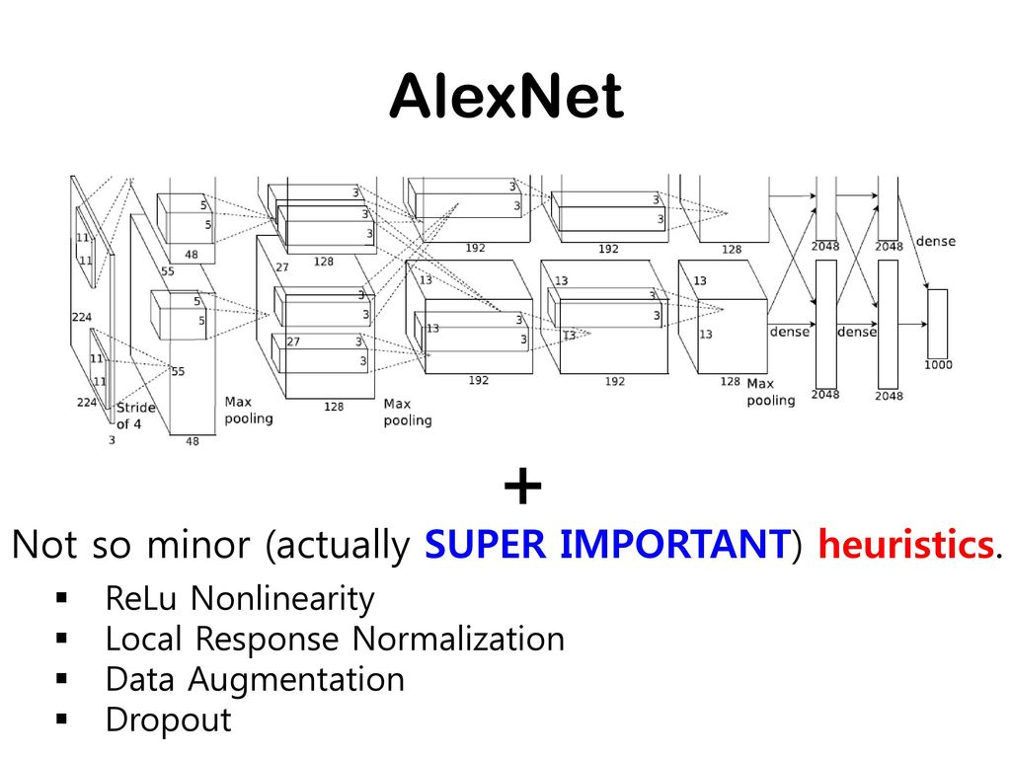

Slide 18
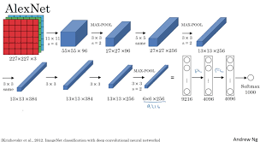

Slide 19
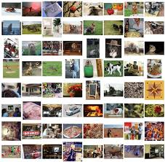
Image Net

